Slide 1
Data Mining Classification: Basic Concepts and Techniques
T.Heba AL.Marwai

Slide 2
Classification: Definition
Given a collection of records (training set )
Each record is characterized by a tuple (x,y), where x is the attribute set and y is the class label
x: attribute, predictor, independent variable, input
y: class, response, dependent variable, output
Task:
Learn a model that maps each attribute set x into one of the predefined class labels y

Slide 3
Examples of Classification Task
Task | Attribute set, x | Class label, y
Categorizing email messages | Features extracted from email message header and content | spam or non-spam
Identifying tumor cells | Features extracted from MRI scans | malignant or benign cells
Cataloging galaxies | Features extracted from telescope images | Elliptical, spiral, or irregular-shaped galaxies

Slide 4
General Approach for Building Classification Model

Slide 5
Classification Techniques
Base Classifiers
Decision Tree based Methods
Rule-based Methods
Nearest-neighbor
Neural Networks
Deep Learning
Naïve Bayes and Bayesian Belief Networks
Support Vector Machines

Slide 6
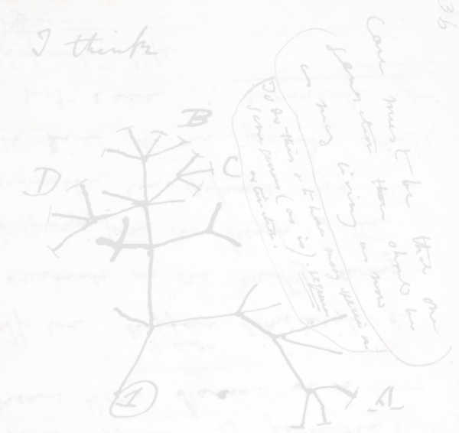
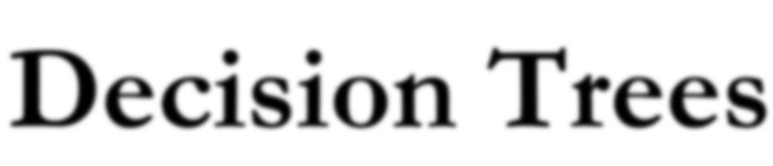


Slide 7
Example of a Decision Tree
categorical
categorical
continuous
class
Splitting Attributes
Home Owner
Yes
No
NO
MarSt
Single, Divorced
Married
Income
NO
< 80K
> 80K
NO
YES
Training Data
Model: Decision Tree

Slide 8
Another Example of Decision Tree
categorical
categorical
continuous
class
MarSt
Single, Divorced
Married
NO
Home Owner
Yes
No
NO
Income
< 80K
> 80K
NO
YES
There could be more than one tree that fits the same data!

Slide 9
Apply Model to Test Data
Test Data
Start from the root of tree.
Home Owner
Yes
No
NO
MarSt
Single, Divorced
Married
Income
NO
< 80K
> 80K
NO
YES

Slide 10
Apply Model to Test Data
Test Data
Home Owner
Yes
No
NO
MarSt
Single, Divorced
Married
Income
NO
< 80K
> 80K
NO
YES

Slide 11
Apply Model to Test Data
Test Data
Home Owner
Yes
No
NO
MarSt
Single, Divorced
Married
Income
NO
< 80K
> 80K
NO
YES

Slide 12
Apply Model to Test Data
Test Data
Home Owner
Yes
No
NO
MarSt
Single, Divorced
Married
Income
NO
< 80K
> 80K
NO
YES

Slide 13
Apply Model to Test Data
Test Data
Home Owner
Yes
No
NO
MarSt
Single, Divorced
Married
Income
NO
< 80K
> 80K
NO
YES

Slide 14
Apply Model to Test Data
Test Data
Home Owner
Yes
No
NO
MarSt
Single, Divorced
Married
Assign Defaulted to “No”
Income
NO
< 80K
> 80K
NO
YES

Slide 15
Decision Tree Classification Task
Decision Tree

Slide 16
Decision Tree Induction
Many Algorithms:
Hunt’s Algorithm (one of the earliest)
CART
ID3, C4.5
SLIQ,SPRINT

Slide 17
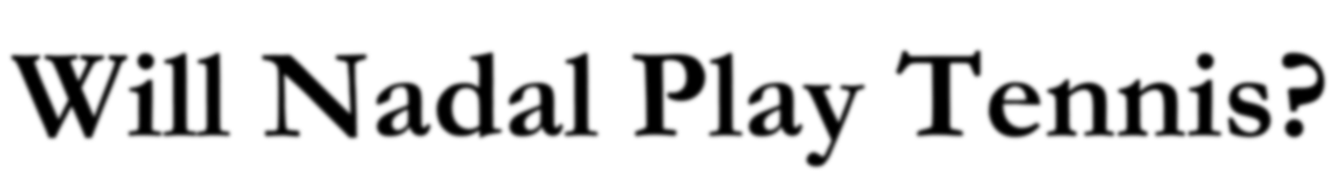



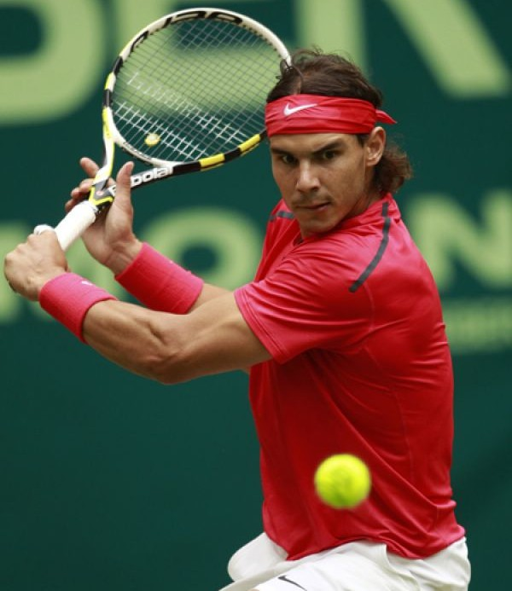
Day Outlook Temp Humidity Wind ^{Play} Tennis
1 | Sunny | Hot | High | Weak | No
2 | Sunny | Hot | High | Strong | No
3 | Overcast | Hot | High | Weak | Yes
4 | Rain | Mild | High | Weak | Yes
5 | Rain | Cool | Normal | Weak | Yes
6 | Rain | Cool | Normal | Strong | No
7 | Overcast | Cool | Normal | Weak | Yes
8 | Sunny | Mild | High | Weak | No
9 | Sunny | Cool | Normal | Weak | Yes
10 | Rain | Mild | Normal | Strong | Yes
11 | Sunny | Mild | Normal | Strong | Yes
12 | Overcast | Mild | High | Strong | Yes
13 | Overcast | Hot | Normal | Weak | Yes
14 | Rain | Mild | High | Strong | No
Rafael Nadal

Slide 18





















Day Outlook Temp Humidity Wind ^{Play} Tennis
1 | Sunny | Hot | High | Weak | No
2 | Sunny | Hot | High | Strong | No
3 | Overcast | Hot | High | Weak | Yes
4 | Rain | Mild | High | Weak | Yes
5 | Rain | Cool | Normal | Weak | Yes
6 | Rain | Cool | Normal | Strong | No
7 | Overcast | Cool | Normal | Weak | Yes
8 | Sunny | Mild | High | Weak | No
9 | Sunny | Cool | Normal | Weak | Yes
10 | Rain | Mild | Normal | Strong | Yes
11 | Sunny | Mild | Normal | Strong | Yes
12 | Overcast | Mild | High | Strong | Yes
13 | Overcast | Hot | Normal | Weak | Yes
14 | Rain | Mild | High | Strong | No
Outlook
Overcast
Humidity
Yes
Wind
No
Yes
No
Yes

Slide 19






































































Question 1
Question 2
Yes
No
Yes
No

Slide 20





















Question 3
Question 4
Yes
No
Yes
No

Slide 21










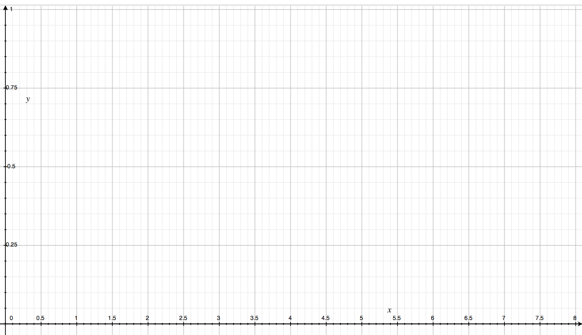


Slide 22



Slide 23



Slide 24



Slide 25



Slide 26



Slide 27



Slide 28



Slide 29



Slide 30
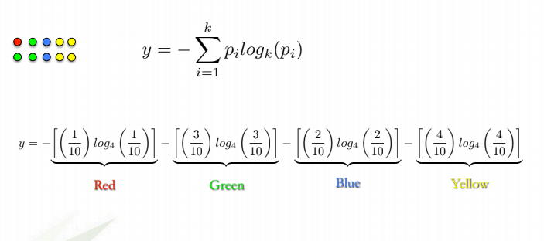

Slide 31



























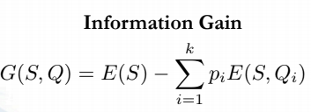
Question 1
Question 2
E=1
E=1
Yes
No
Yes
No
E=0.97
E=0.92
E=0.72
E=0

Slide 32
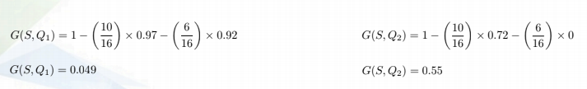
Question 1
Question 2
E=1
E=1
Yes
No
Yes
No
E=0.97
E=0.92
E=0.72
E=0

Slide 33
Day Outlook Temp Humidity Wind ^{Play} Tennis
1 | Sunny | Hot | High | Weak | No
2 | Sunny | Hot | High | Strong | No
3 | Overcast | Hot | High | Weak | Yes
4 | Rain | Mild | High | Weak | Yes
5 | Rain | Cool | Normal | Weak | Yes
6 | Rain | Cool | Normal | Strong | No
7 | Overcast | Cool | Normal | Weak | Yes
8 | Sunny | Mild | High | Weak | No
9 | Sunny | Cool | Normal | Weak | Yes
10 | Rain | Mild | Normal | Strong | Yes
11 | Sunny | Mild | Normal | Strong | Yes
12 | Overcast | Mild | High | Strong | Yes
13 | Overcast | Hot | Normal | Weak | Yes
14 | Rain | Mild | High | Strong | No

Slide 34













E=0.954
Wind
E=0.811
E=1

Slide 35







G(S, Wind) = 0.048
E=0.954
Humidity
E=0.985
E=0.592

Slide 36












G(S, Wind) = 0.048
G(S, Humidity) = 0.151
E=0.954
Temp
Mild
E=1
E=0.92
E=0.81

Slide 37






G(S, Wind) = 0.048
G(S, Humidity) = 0.151
E=0.954
G(S, Temp) = 0.042
Outlook
Overcast
E=0.971
E=0
E=0.971

Slide 38






















Outlook
Overcast
Humidity
Yes
Wind
No
Yes
No
Yes

